Slide 1
Discussion Topics
Registry ‘101’
Good resources:
Inside the Registry by Mark Russinovich
http://technet.microsoft.com/en-us/library/cc750583.aspx
Harlan Carvey’s Windows Registry Forensics
Registry data recovery & analysis
Registry artifacts
Some important ones
… But this is only the beginning!
… We could spend weeks on the Registry!

Slide 2
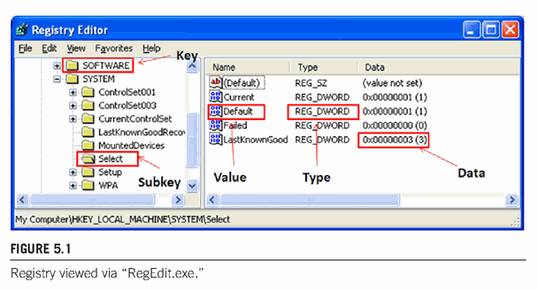
Registry Overview
Purpose
Store configuration info for apps, h/w, devices, user
Replace old autoexec.bat, config.sys, *.ini files
Format
‘Centralized hierarchical database’ (per Microsoft)
NOT a database in traditional sense
Hierarchical relationships are accomplished via parent-child structure for key-value structure
Keys
Subkeys
Values
Data
Carvey (2012) Windows Forensic Analysis, 3rd Ed.

Slide 3
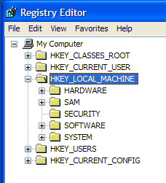
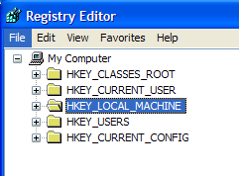
Registry Overview
Data to create/populate hives are stored in five files
C:\Windows\System32\Config\
System, SAM, Security, Software
NTUSER.dat and USRCLASS.dat files stored per user in each user folder
File types – app. mapping
derived from Software file
User logged on
SOURCE
FILES:
SAM
Security
Software
System
Volatile hive created
at start-up, not allocated
NTUSER.dat
USRCLASS.dat
H/W profile to use at start-up
derived from HKLM\Hardware

Slide 4
Registry Files
SAM
“Password file” (pw hashes, correlate users to SIDs, etc.)
Security
Stores local security data
Software
OS & application configuration data
System
System identification & configuration info/settings
NTUSER.dat + USRCLASS.dat
Individual user usage data
So each user has these (paired set ≥ Win7, only NTUSER.dat ≤ WinXP)
Notes:
WinXP era = only NTUSER.dat
With Win7, User Access Control… USRCLASS.dat file created to contain registry data that the UAC said couldn’t write to NTUSER.dat or other registry files, so stored in USRCLASS.dat
NTUSER.dat file stored in %UserProfile%
USRCLASS.dat file stored in %UserProfile%AppData%Local%Microsoft%Windows

Slide 5
Registry Data Structures
Data types (common ones)
REG_BINARY Raw binary data
REG_DWORD 32bit integer
REG_SZ Fixed length string
REG_EXPAND_SZ Variable length string
REG_MULTI_SZ Multiple strings separated by delimiter

Slide 6
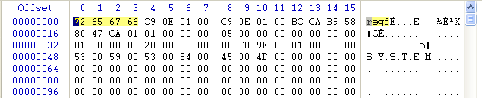
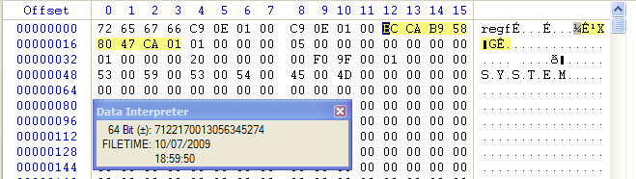
Registry File Header
File signature: \x72 65 67 66 (“regf” in ASCII)
Last updated date/time: offsets 12-19
File path and/or name: starting offset = 48
File signature
File last updated d/t
(not key/subkey d/t stamp)
File path/name

Slide 7
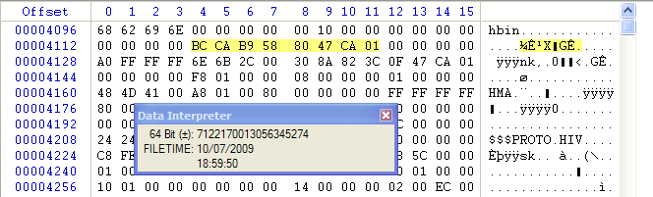
Registry Cells (hbin blocks)
Keys, subkeys, and values allocated in 4KB ‘cells’ in Registry file
‘Cells’ are blocks of data (like $MFT entries)
Sometimes called ‘hbin blocks’ because of their ‘hbin’ ASCII signature
When keys & values are deleted, space is de-allocated
Data remains until overwritten (‘Registry slack’)
32 byte hbin header
Offsets 4-7: Offset from first hbin block
Offset 8-11: Offset to next hbin block (tells key/value alloc. size)
Offsets 20-27: Last modified date/time (in first hbin block only)
Offsets 36-37: hbin block type (if named)

Slide 8
hbin Block Types & Data Structures
*nk type data structure:
hbin block types
nk – key name*
lf – subkey list (aka ‘lh’)
vk – key value
sk – security key
Value lists (no type ID)
Class info (no type ID)
Data (no type ID)
Offsets | Description
0-3 | Header/entry length**
4-5 | “nk” header (\x6E6B)
6-7 | Key type (\x2C00=root, \x2000=subkey)
8-15 | Key modified date/time
20-23 | Offset to owner/parent key
24-27 | Number of subkeys
32-35 | Offset to subkey list
40-43 | Number of values
44-47 | Offset to value list
76-77 | Key name length
80+ | Key name
** Usually \xA0FFFFFF (signed 160) or \xA8FFFFFF (signed 168)
SIGN = unallocation status (FFFFFF = neg. = allocated; 000000 = pos. = unalloc.)

Slide 9
hbin Block Types & Data Structures
nk points to value list (offsets 44-47 in nk)
Offsets 0-3 in value list: signed integer for length
Offsets 4-7 in value list: offset to first value (first of vk’s)
vk (key values) data structure
Offsets 0-3: signed integer for header/entry length
Offsets 4-5: key type
Offsets 10-11: resident / non-resident status
Residency relative to ‘cell’
If resident, value immediately follows key name
If non-resident, value stored elsewhere in registry file
Offsets 12-15: offset to non-resident value

Slide 10
Registry Carving
Carving for deleted Registry files
Carving for unallocated cells (keys/values) within allocated or unallocated Registry files
E.g., Carve for services keys & sort based on lastwrite date/times … will show service install dates; can help ID rootkit related services, etc.
E.g., Carve for artifacts of uninstalled software
Carving for regf files and keys/values in memory

Slide 11
“Use Cases” / Investigative Questions
Was that drive ever plugged into this system?
When was that drive plugged into the system?
When was it first plugged in?
When was it last plugged in?
Who was logged in when it was plugged in?
Did my employee copy company sensitive data to a thumb drive?
What drives has this user used with this machine that we should be searching / asking for?

Slide 12
USB Devices: Forensic Background Info
External hard drives have a drive signature in MBR
Thumb drives have unique serial numbers (s/n) in their device descriptor (in firmware)
Usually, anyway…
Old, old drives do not
Manufacturers who don’t comply with the standard do not
Manufacturers who don’t comply with the standard may use the same serial number for multiple drives of the same model
Drivers must be installed on the machine for r/w access
Thus, entries in setup.api log (setupapi.dev.log)

Slide 13
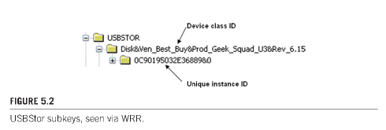
Step 1: USBStor Key
What USB devices have been plugged in to the machine?
System hive (file)
HKLM\System\CurrentControlSet\Enum\USBStor
Note: There is no “CurrentControlSet” key
See ControlSet001, ControlSet002, etc. – then Select key
USBStor key lists thumb drives inserted in machine
Device ID shows ‘make/model’
LastWrite d/t of Device ID = when first connected since last reboot
Unique Instance ID shows serial number from firmware*
LastWrite d/t of Unique Instance ID = when last connected
*Unless 2nd character is “&”
Then it’s a Windows assigned ‘Parent Prefix’

Slide 14
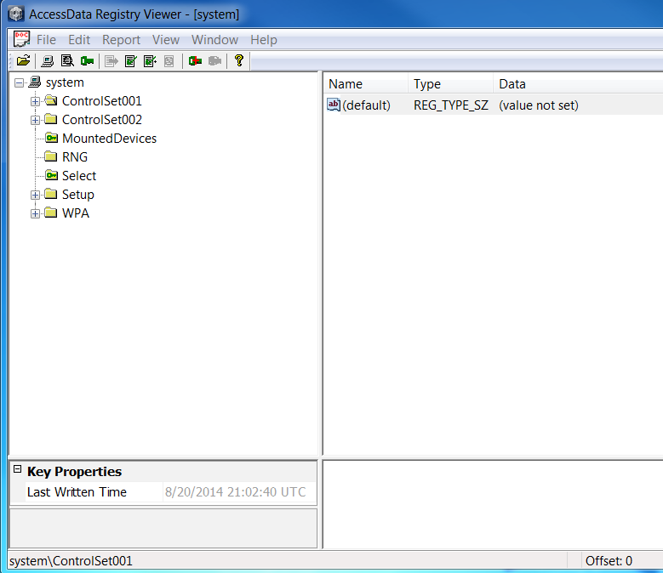

Slide 15
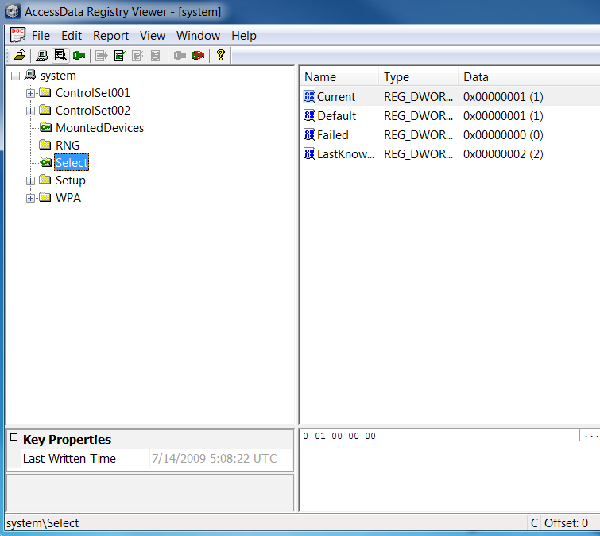

Slide 16
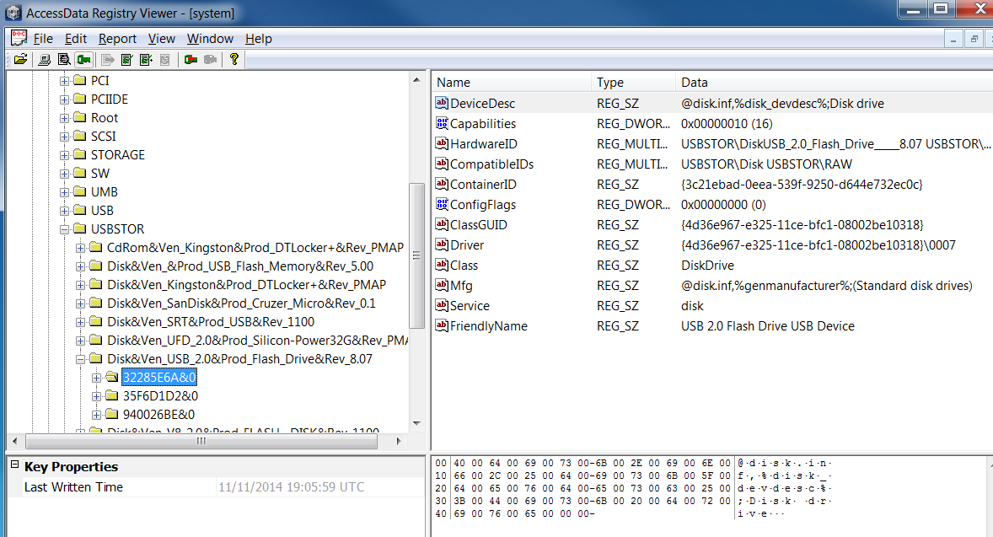
Unique instance ID
SYSTEM\ControlSet###\Enum\USBStor

Slide 17
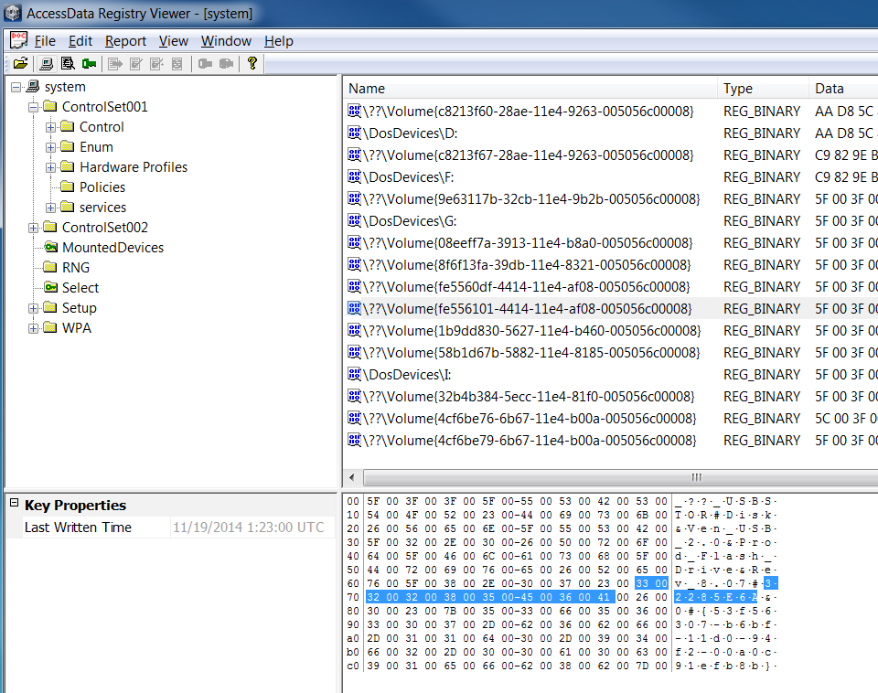
The drive in question was assigned drive letter G:\ when last installed

Slide 18
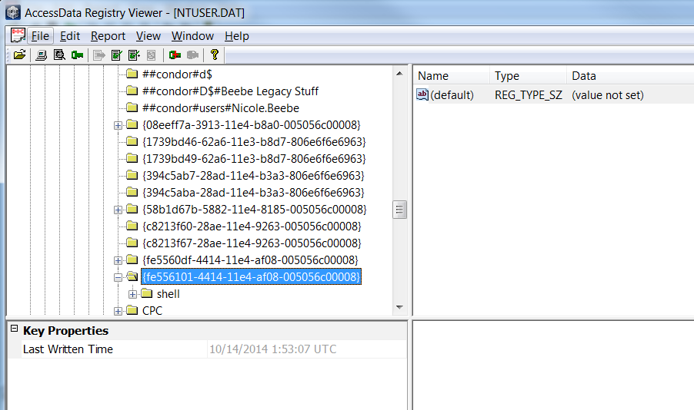
By who?.... Which user account’s NTUSER.dat file is this?
Notes:
Last written d/t stamp for the corresponding key in the NTUSER.dat file MountPoints2 key…
??The USB drive in question was last inserted into this system (by this user account) on 10/14/14 1:53:07 UTC.
??The USB drive in question was first inserted into the system (ever… not “since last reboot”) on 10/14/14 1:53:07 UTC.

Slide 19
Step 4: ‘Go the other way…’
Instead of tracking from device to user… track from user to device…
What other drives should we look for (that this user used)?
NTUSER.dat → MountPoints2 Key → drives listed
Search in SYSTEM MountedDevices key for volume GUID
Obtain Unique Instance ID or drive signature from value data
Track Unique Instance ID or drive signature back to Enum\USBStor so know make/model you’re looking for
Then search for or ask your suspect where their fill in the blank with specific drive info is and watch a look of shock appear on their face! ;)

Slide 20
Basic System Information
Key info regarding the configuration of the system
Registry file: System
Must identify proper current control set (%CCS%)
Registry contains current registry & ‘last known good’
ControlSet001 & ControlSet002
Select\Current key value indicates which is the current one
Select\LastKnownGood value is the previous registry state
Timezone info: …\%CCS%\Control\TimeZoneInformation
Computer name: …\%CCS%\Control\ComputerName
Last shut down: …\%CCS%\Control\Windows\ShutDownTime
Registry file: Software
OS install data: …\Microsoft\Windows NT\CurrentVersion
Product, registration, version, date, etc.
Notes:
%CCS% = CurrentControlSet = ControlSet### depending on Select key’s ‘Current’ value data
Bias value = standard time, minutes off GMT (e.g. 360 for CST, AKA 6 hrs)
If ActiveTimeBias value = Bias value, then in standard time.
Else, ActiveTimeBias value = 300 (then ‘sprung ahead 60 min… ActiveTimeBias is 60 minutes off Bias value, thus in CDT)
Last shut down time – go to key, highlight 8 bytes in data, right-click show, show hex interpreter window (often matches key last write time, but NOT ALWAYS!)

Slide 21
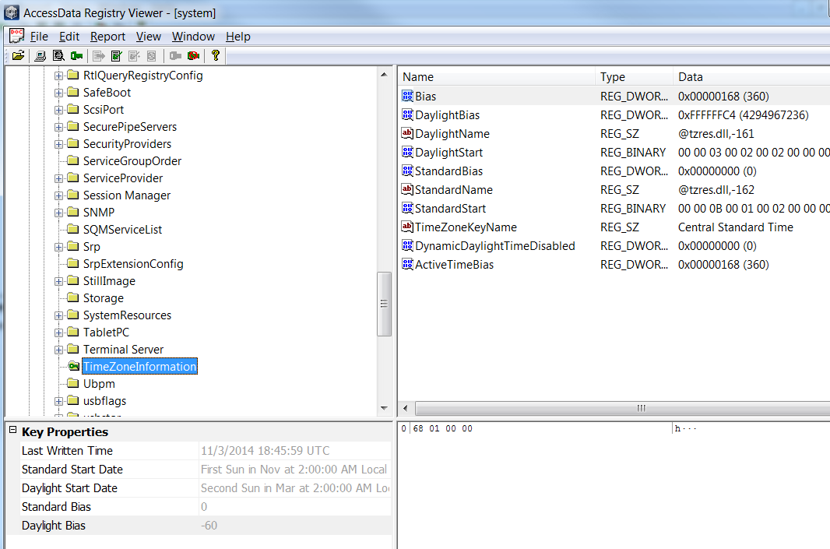
Notes:
ActiveTimeBias and Bias are both 360 (6 hours), so set to central standard time.
If ActiveTimeBias had been 300 and Bias had been 360, then we’d new we’re on central daylight time.

Slide 22
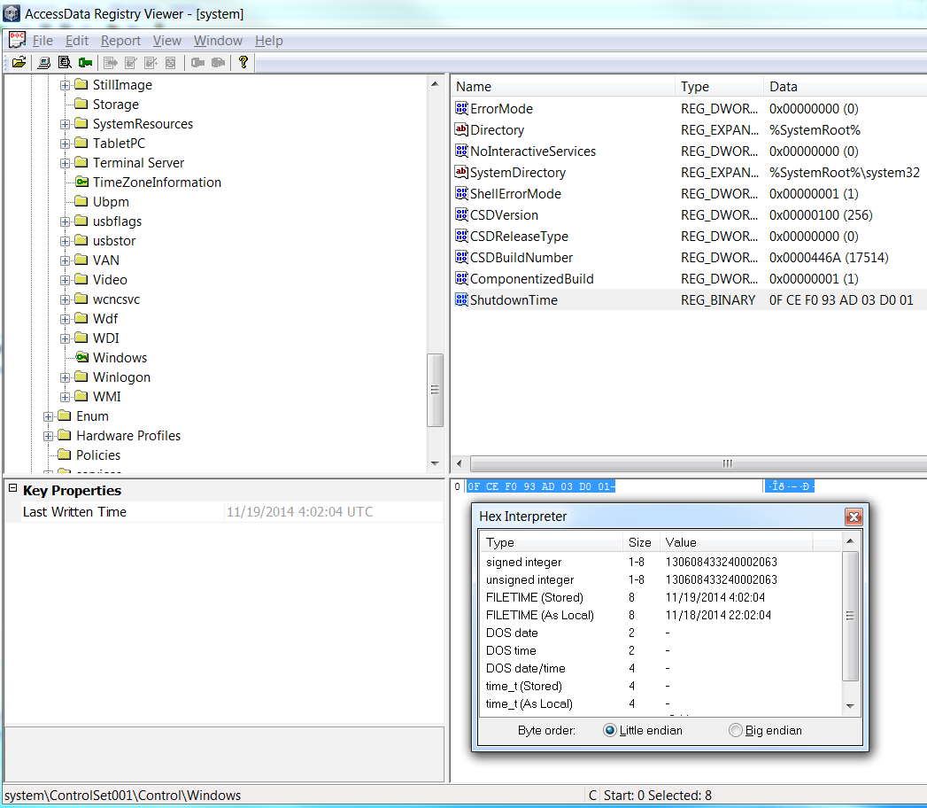

Slide 23
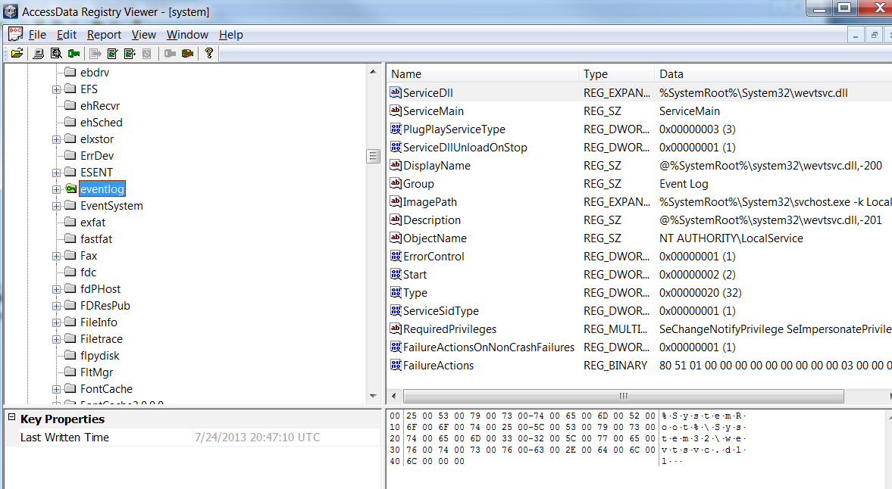
Notes:
SYSTEM\CurrentControlSet\Services\Eventlog

Slide 24
Analyzing Available Services
Important with compromises, data breaches, malware infections, etc.
HKLM\System\CurrentControlSet\Services
Not all items listed are actually services (i.e. device drivers)
Start values
0x02 – autostart on boot (helps persistence)
0x03 – manual start
See Microsoft KB article 1030000 for other value info
Uninstall apps/services = lose app subkeys in Services key
Look in HKLM\System\Enum\Root
Key: LEGACY_<service name from above> (LastWrite d/t = 1st use)
Subkey: 0000 (LastWrite d/t = last use)

Slide 25
Installed Programs
Config info & uninstall mechanism stored in Registry
Registry file: Software
Examine keys in root of Software hive (for installed apps)
Software\Microsoft\Windows\CurrentVersion\Uninstall
Folder per installed app (that has uninstall function)
Folder created during install & not changed, so key last written time typically corresponds with application install date
Sometimes folder & other app data remains even after uninstall
Software\Microsoft\Windows\CurrentVersion\App Paths
Folder per installed app
Includes things installed w/o Microsoft Installer package (.msi)
Registry file(s): NTUSER.dat
Apps installed for use by specific users, not all users (global)
Uninstall doesn’t normally clear UserAssist entries either

Slide 26
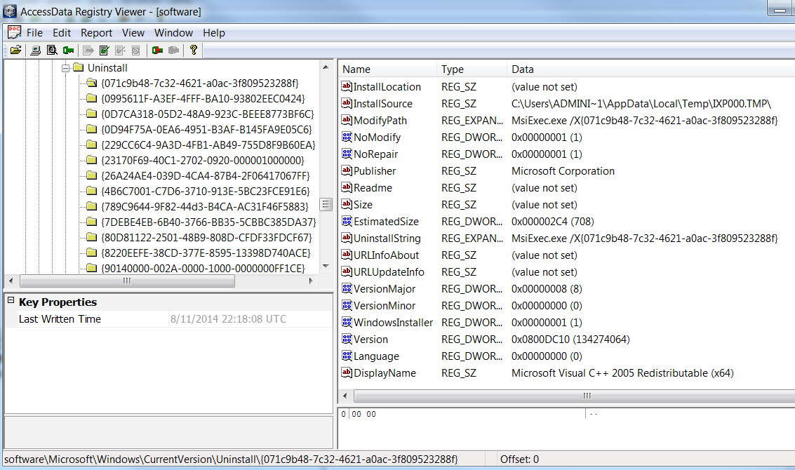
Notes:
Older versions of windows stored app names as sub-key names under SOFTWARE\Microsoft\Windows\CurrentVersion\Uninstall
Newer versions of windows stores GUIDS as sub-key names… need too look at DisplayName and other values/data to determine apps

Slide 27
Application Persistence
Malware can ensure persistence via Registry edits
Registry file: Software
…\Classes\{file class}\Shell\Open\Command
Defines system action when file (by class) is opened (right-click, Open)
Hackers modify key to open additional things, so open Solitare and…
{file class} examples: Exefile, Word.document.x (where x=version)
…\Microsoft\Command Processor\AutoRun
So, when run cmd.exe, also run….
…\Microsoft\Windows NT\CurrentVersion
\Windows\AppInit_DLLs
Load specified DLLs into memory whenever a GUI app is started
\WinLogon\Notify
Ability to alert someone externally of some system event/status
\WinLogon\TaskMan
Doesn’t exist by default, but can create to have system use different task manager

Slide 28
Autostart Locations
Programs that run upon system boot, auto start, etc.
Registry file: Software
…\Microsoft\Windows\CurrentVersion…
Way more than ‘Run’ & ‘RunOnce….Explorer, Shell, Policies, DLLs, WinLogon
…\Classes
…\Microsoft\Command Processor
Registry file: System
…\%CCS%\Control\Sesson Manager\BootExecute
…\%CCS%\Services
Any with ‘Start’ value set to \x02 are automatic starting
Registry file: NTUSER.dat
....\Software\Microsoft\Windows\CurrentVersion…
Applets, Explorer
Good tool: SysInternal’s AutoRuns

Slide 29
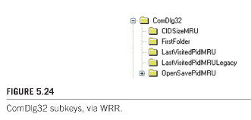
“MRU” (Most Recently Used)
OS & application recall of last X docs/files used
MRU keys could be anywhere, depending on app design
http://www.forensicswiki.org/wiki/List_of_Windows_MRU_Locations
Common areas
Registry File: NTUSER.DAT
…\Microsoft\Windows\CurrentVersion\Explorer\RecentDocs
Sub-keys organized by file type
…\Microsoft\Windows\CurrentVersion\Explorer\ComDlg32
If app uses standard Windows Open dialog box, then MRU list in
WinXP Sub-keys*:
LastVisitedMRU (tracks app used to open a file via file > Open)
OpenSaveMRU (tracks files opened/saved via Open or Save As)
…\Microsoft\Windows\CurrentVersion\Explorer\RunMRU
Tracks things run via Start > Run
*Win7:
Notes:
Good article on shellbag MRU forensics: http://www.dfrws.org/2009/proceedings/p69-zhu.pdf
Note, ComDlg32 = Common Dialog libraries can be used by any Windows application and Microsoft highly recommends that developers use them instead of creating novel user interface elements
OpenSaveMRU and LastVisitedMRU keys are part of the ComDlg32 key

Slide 30
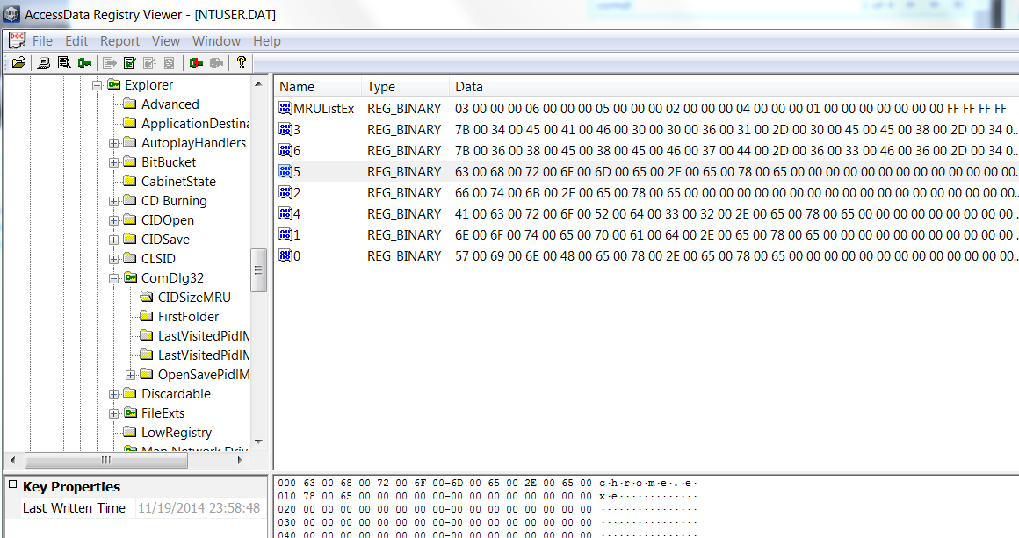
MRUListEx value data shows recency order of MRU values via 4B data structures (ex. 03000000 06000000 05000000…)
Registry Viewer displays them in order based on MRUList value
RegEdit doesn’t display values according to MRUList value
GUID or app name of item most recently used

Slide 31
MRU (cont.)
Standard ordering convention
Keys are numbered (with numbers or letters) (key name)
Key values include command, path/filename, link info, etc.
‘MRUList’ (name varies) key then defines order
First number/letter listed is MOST recently used, last number/letter in list is the item used longest ago
MSOffice tracks MRU elsewhere
Registry file: NTUSER.dat
…\Software\Microsoft\Office\14.0\...

Slide 32
IE - PSSP (Protected Storage System Provider)
Where sensitive IE data is stored
Registry file: NTUSER.dat
…\Software\Microsoft\Protected Storage System Provider\<SID>\Internet Explorer\Internet Explorer
128bit encryption, but static key stored in Registry
Data stored
Form data
Outlook & Outlook Express passwords
Website logon/pw info
Web search queries
Notes:
Need to update for Win7/later versions of IE

Slide 33
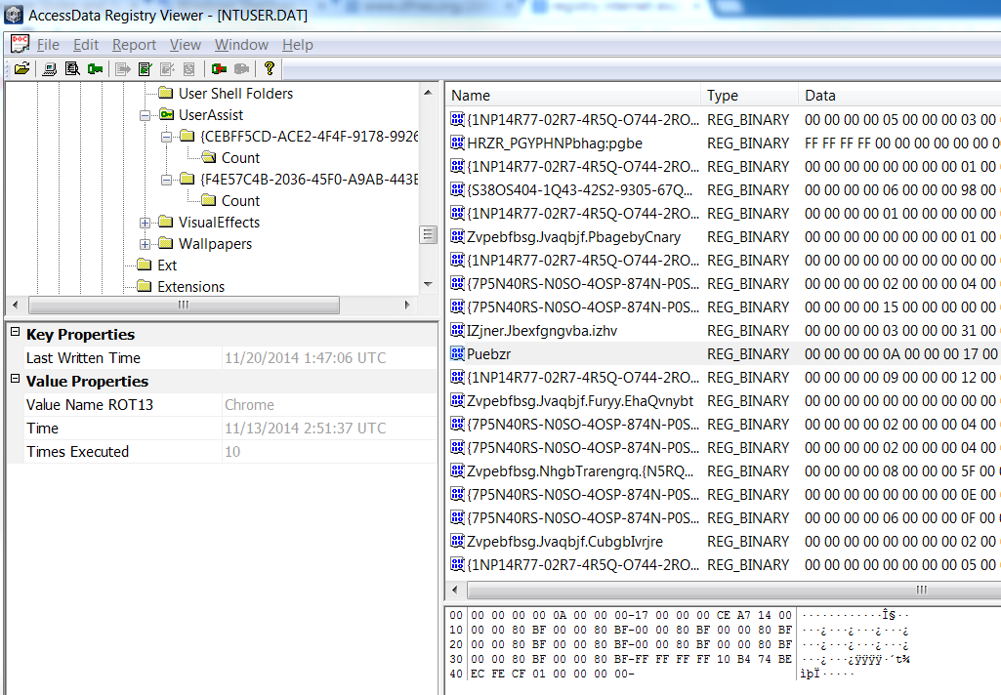
UserAssist

Slide 34
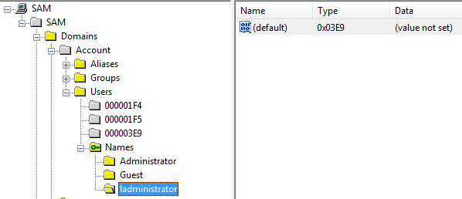
SAM Registry File
Utility
Identify user accounts by name and RID
User’s RID (in hex)

Slide 35
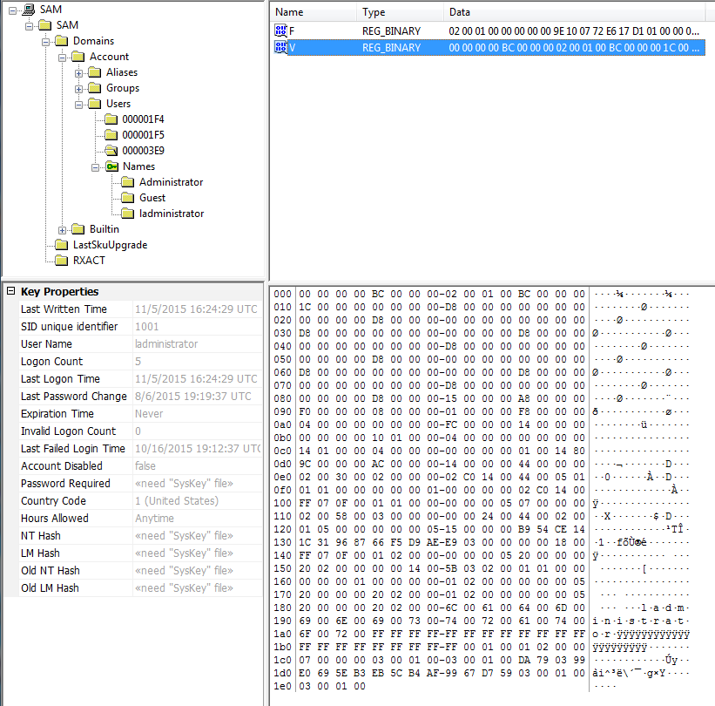
V Value data
Full name for the account
Path to login script
Encrypted PW hashes

